Slide 1

🞭 Dharani Anthireddy
🞭 Shajahan Sayyed
🞭 Neeraj Babu Vaddepalli

Slide 2
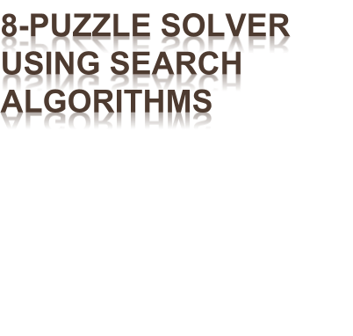
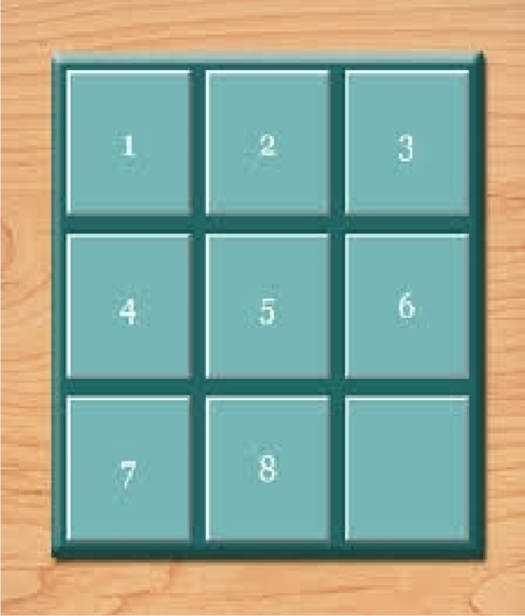
Explore the world of artificial intelligence through an 8-puzzle solver project. This presentation outlines our approach to implementing and analyzing various search algorithms for solving the classic sliding tile puzzle.

Slide 3
PROJECT OBJECTIVES
Main Goal
Design an efficient 8-puzzle solver using various search algorithms.
1
Algorithm Implementation
Implement BFS, DFS, A*.
2
Performance Analysis
Compare algorithms' time, memory usage, and path optimality.
3
Scalability
Test algorithms on varied puzzle difficulties and explore potential generalizations.
4

Slide 4
Algorithms
Heuristics for A*
Manhattan Distance
Tools
Python
heapq library
numpy library
Pycharm or VScode
🞭 Breadth-First Search (BFS)
🞭 Depth-First Search (DFS)
🞭 A* Search with heuristics

Slide 5

🞭 Project Report
🞭 Codebase
🞭 Heuristic Comparison Summary
🞭 Algorithm Performance Insights
🞭 Presentation
🞭 Youtube Video
🞭 Github Repository

Slide 6


Metric | Description
Execution Time | Time taken to reach solution
Memory Usage | Amount of memory consumed
Solution Optimality | Shortest path verification
Nodes Explored | Total states visited
Scalability | Performance across varied configurations

